Slide 1
Presentation for English Course
Dmitri Ivanovich Mendeleev — great man of science
Prepared by students of group 221-352
Baratelia Timur Ivanov Vladislav

Slide 2
Introduction
Childhood
University years
The start of scientific activity
Popular scientific discoveries
The last years of his life

Slide 3
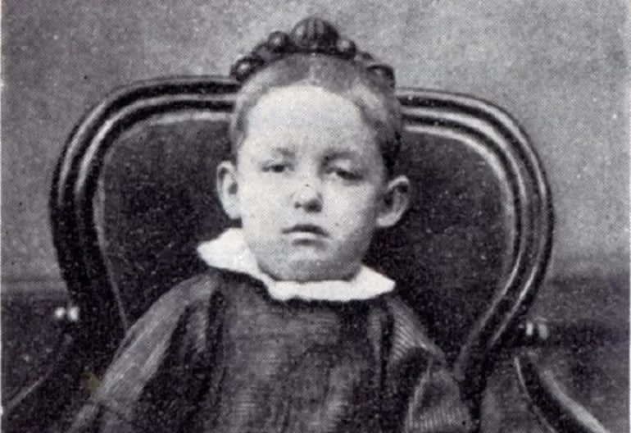
Childhood
Dmitri Ivanovich Mendeleev was born on 8 February 1834 near Tobolsk. Mendeleev’s parents were Maria Mendeleeva (nee Kornilieva) and Ivan Mendeleev.

Slide 4
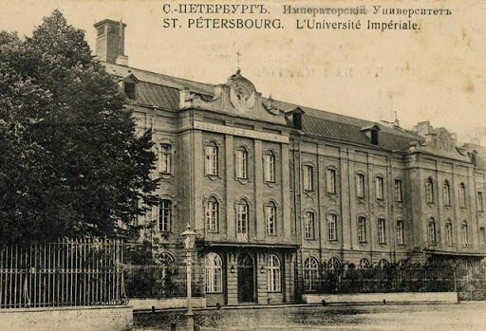
University years
In 1847 he entered the Gymnasium in Tobolsk. In 1850 Mendeleev joined The Main Pedagogical Institute.

Slide 5
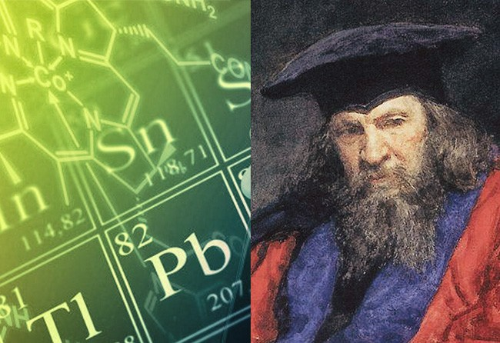
The start of scientific activity
From 1859 to 1861 Mendeleev worked in Heidelberg and researched the capillarity of liquids. In 1865 Mendeleev completed his dissertation "On the Combinations of Water with Alcohol“ In 1906 the Nobel Committee for Chemistry suggested to the Swedish Academy to award the Nobel Prize in Chemistry for 1906 to Mendeleev for his discovery of the periodic system.

Slide 6
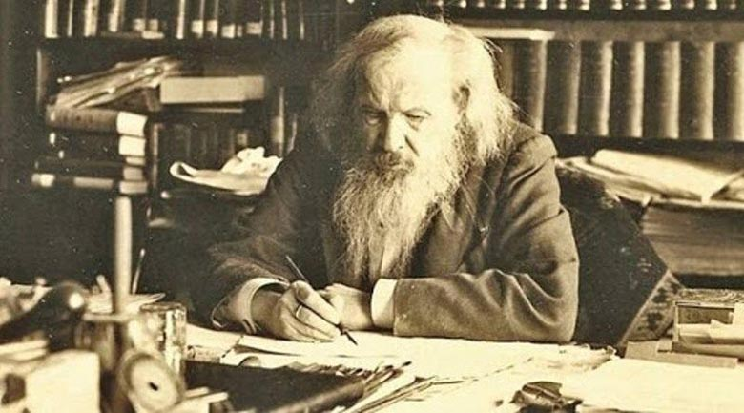
Popular scientific discoveries
1) periodic table of chemical elementsThe special theory of relativity 2) pyrocollodic gunpowder
3) pycnometer

Slide 7
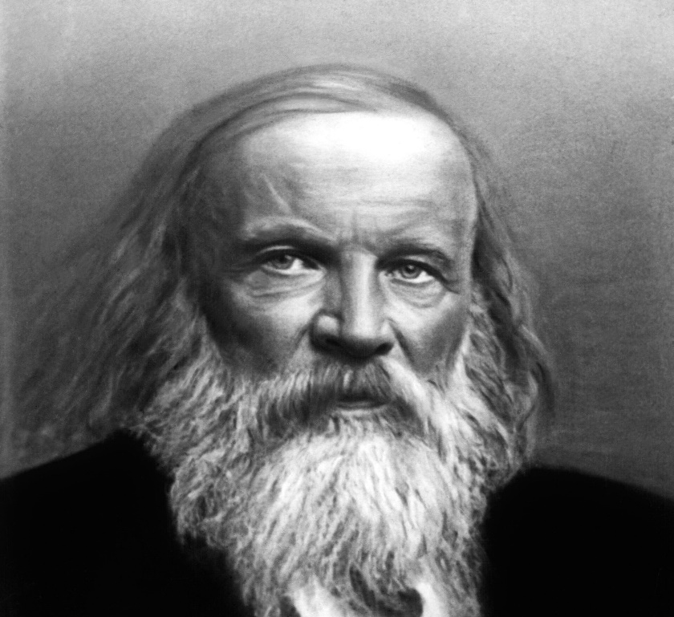
The last years of his life
Dmitri Mendeleev died of influenza in Saint Petersburg in 1907.

Slide 8
THE END
Thank you for your attention!

